Slide 1
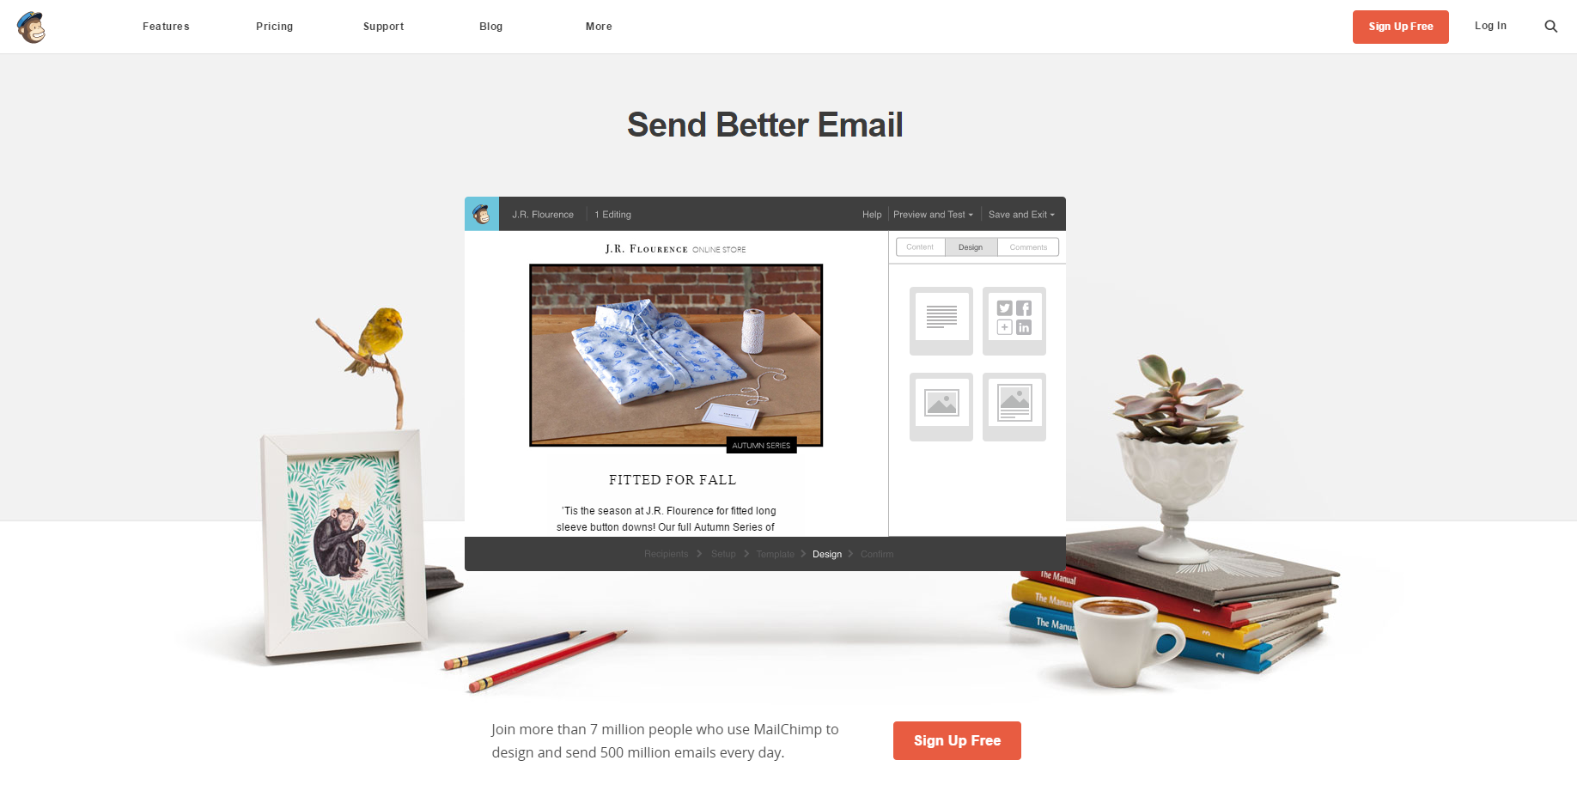
This is MailChimp, a free email service

Slide 2
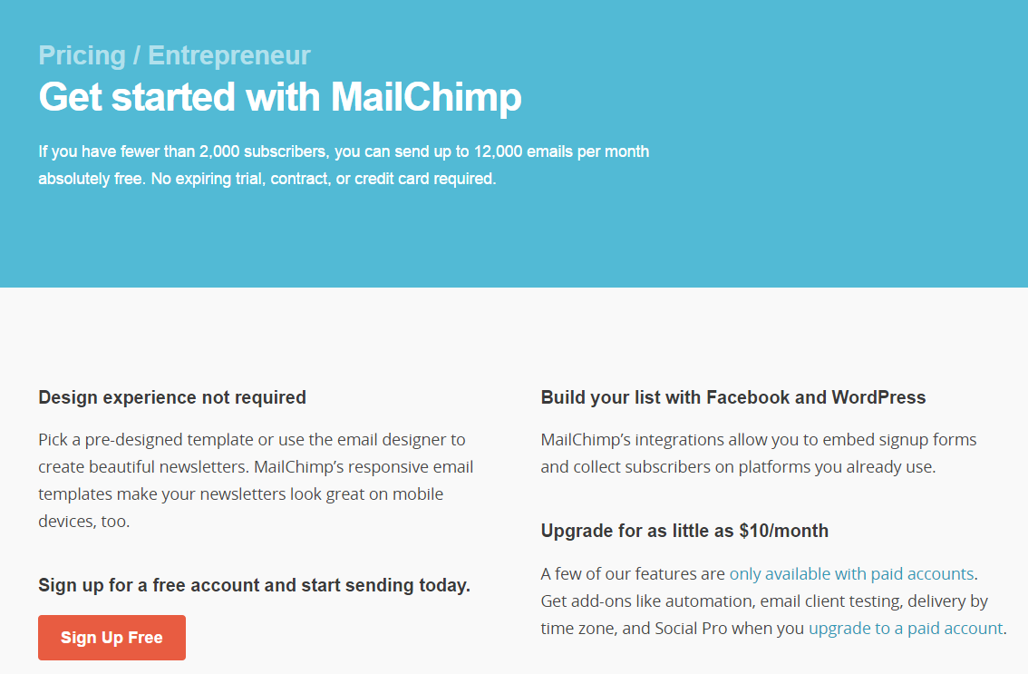

Differences: beautiful, simple, easy to use, + 100% free
7 million people use MailChimp to design and send 500 million emails every day.
It’s free for fewer than 2,000 subscribers and up to 12,000 emails per month.

Slide 3
Mobile story + feature highlights
MOBILE FOR YOU AND YOUR SUBSCRIBERS
MailChimp works on desktop browsers, tablets, and mobile devices.
All of MailChimp's templates are mobile friendly right out of the box. You shouldn't have to think about whether or not your campaigns will look good on your subscribers' screens.
MailChimp provides a useful mobile application for both the iPhone and Android-based mobile devices.

Slide 4
It’s super social, works with Twitter + Facebook pages
Social sharing
Share your campaigns on social networks with one click in the campaign builder, and add buttons to your campaigns so your readers can spread the love, too.
Social integrations
MailChimp integrates with the social networks you and your customers already use. Automatically tweet and share campaigns, and allow people to sign up for your newsletter on Twitter or Facebook.

Slide 5
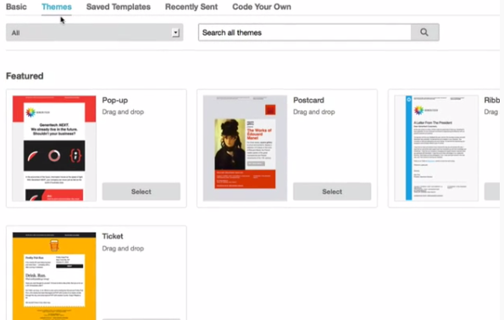
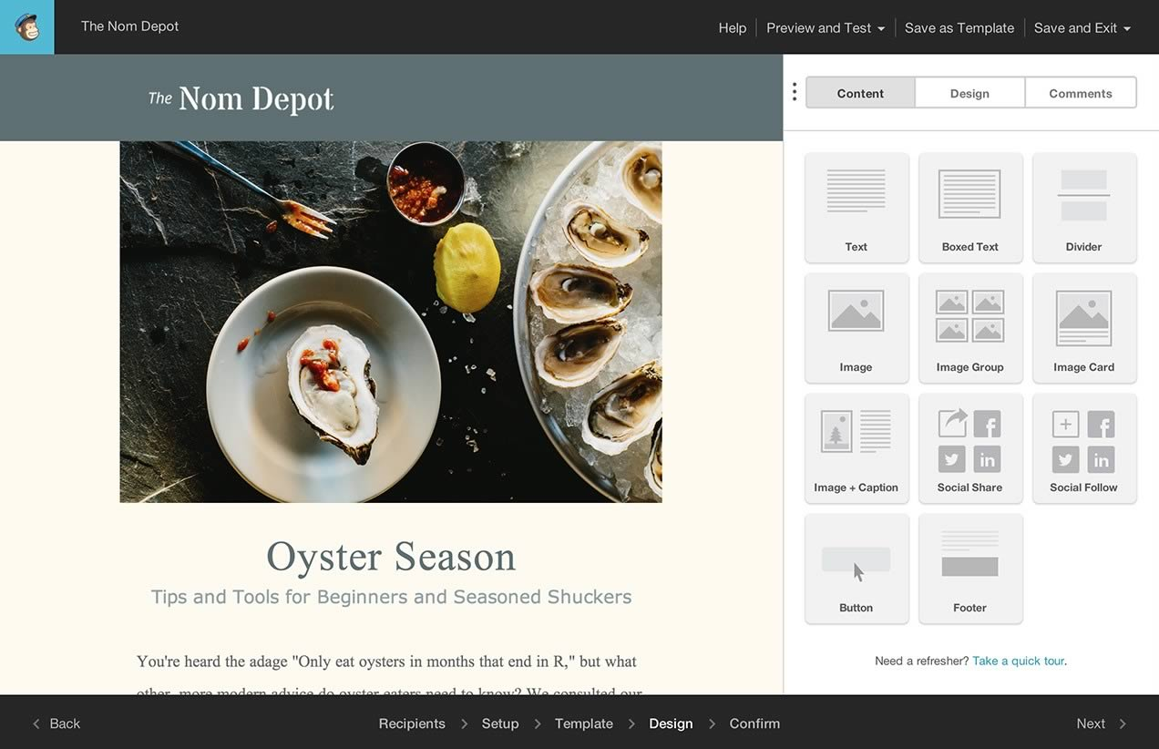
Getting started + templates

Slide 6
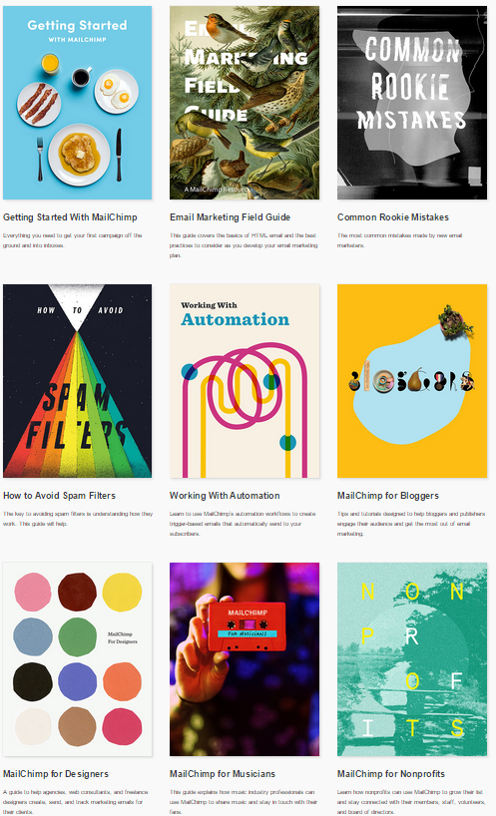

How-to guides + quick answers that keep you moving
MailChimp's videos, ebooks, and guides offer information for email marketing rookies, experts, and everyone in between to create effective, dynamic campaigns.
MailChimp even offers a tool that tells you how well a potential subject line will perform based on history and industry statistics.

Slide 7
Tracking + analytics: See how effective your emails really are
EXTENSIVE ANALYTICAL TRACKING:
MailChimp reports use interactive graphs, enabling you to easily view activity associated with your emails. Reports reveal open and click rates, opens by location, bounces, unsubscribes, and more. The reports even enable you to compare your rates against other email marketers in a similar industry. MailChimp integrates with Google Analytics, which provides additional insight into your campaigns so you can see how much revenue your campaigns are creating.
All of these tracking and reporting tools positively influence your ability to create effective email marketing campaigns and better reach the right types of customers.

